Slide 1

PHASE 2 — IDEATION & PLANNING
Team Hayagreeva
Project Title: AI Powered Digital Safety Co-Pilot
Team Members | Roles
Prateek Deshpande | Team Leader
Adithi D S | Team Member, Testing
K Aasritha Vardhan | Team member, Development
Satvik Pandurangi | Team member, Development
MENTOR
DATE
REPOSITORY
Mr. AK Anand
05.09.2026
https://github.com/Udyoga-Pramoda-Hackathon-2026/team-hayagreeva.git
Notes:
Fill in your team details. Do not change the deck structure.

Slide 2
SECTION 01
Solution
What are we building, who is it for, and what does it solve?
WHAT WE ARE BUILDING
WHO IT IS FOR
PROBLEM IT SOLVES
We are building a Sudarshana Kavach Sudarshana Kavach is an AI empowered website to help Senior citizens and people with less tech savvy to check the fraudulent activities behind the SMS, Email, QR Codes received.
Primarily targeting people with less technical knowledge about online scams, typically aged over 50.
Creates an awareness among users on whether to trust a hyperlink received in the communication as a genuine one or fraudulent one.
Notes:
What you are building, for whom, and the problem it solves.

Slide 3
SECTION 02
Value proposition
Six lines. Together they should read as one sentence.
For
Senior citizens and people with less knowledge on online scams
Who
Can get some awareness about the scams by using
Our product
Sudarshan Kavach
That
Helps to identify the possible scam by providing the risk involved and analysis
Unlike
A situation where we are on loosing end without an awareness
We
Want to make sure hard earned of our senior citizens and ladies to be safe and secure while using the digital payments.
Notes:
Complete the six-part statement. Read it aloud — it should sound like a sentence.

Slide 4
SECTION 03
Core user journey
Trigger to outcome, in seven steps.
Trigger
User entry
User action
System / AI
Result
User action
Outcome
User receives a communication in form of SMS, Whatsapp msg, email, QR Codes etc
They arrive normally as ads or as a phishing attacks in emails, whatsapp msgs etc
When such communication is received user should take a screenshot or simply copy the text on to the Sudarshan Kavach
Once user provides the information to our system it will check the possible fraud and provides a detailed risk analysis, appropriate action as well.
Risk analysis will be provided normally in small, medium and high based on the calibrated mode.
They can remove the msg completely if any action hasn’t been taken yet. Or can follow the procedure to report the fraudulent activity with concerned department.
a penny saved is a penny earned. We will make user aware of the possible attempt to scam him/her and also make aware about the reporting if already fell prey for the scam.
Notes:
Seven steps from trigger to outcome. Mark clearly where AI acts.

Slide 5
SECTION 04
Core features
Every feature must solve a problem you found in Phase 1.
FEATURE
PROBLEM SOLVED
MVP PRIORITY
SMS, Checking and WhatsApp messages checking
To identify the possible phishing attack
MUST
QR Code validation, Hyperlink validation
Stop providing personal information to scamsters
MUST
Real time checking of phishing attack
Live check and filtering by providing possible next steps
SHOULD
Video call validation
Identify the deep fake problems
COULD
Notes:
Each feature must map to a problem. Priority is Must / Should / Could.

Slide 6
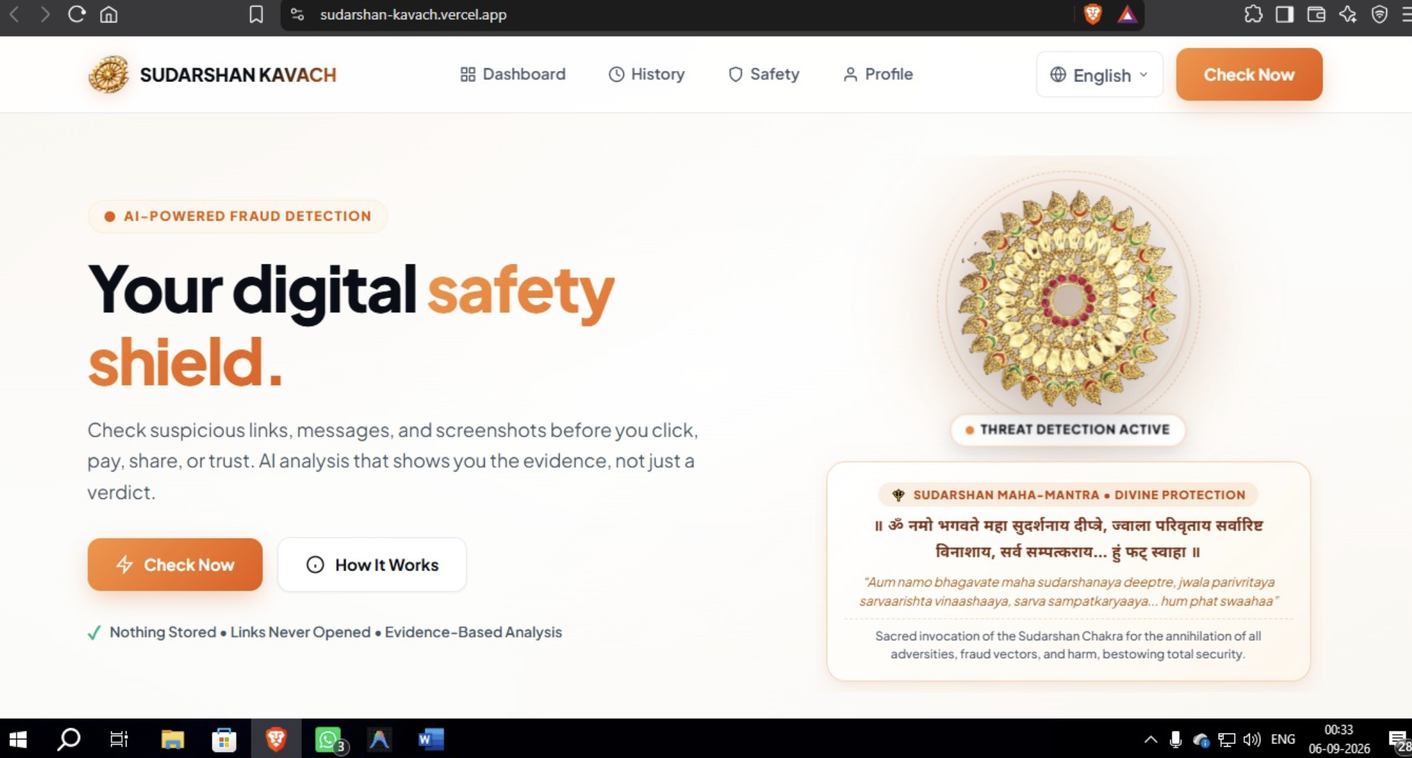
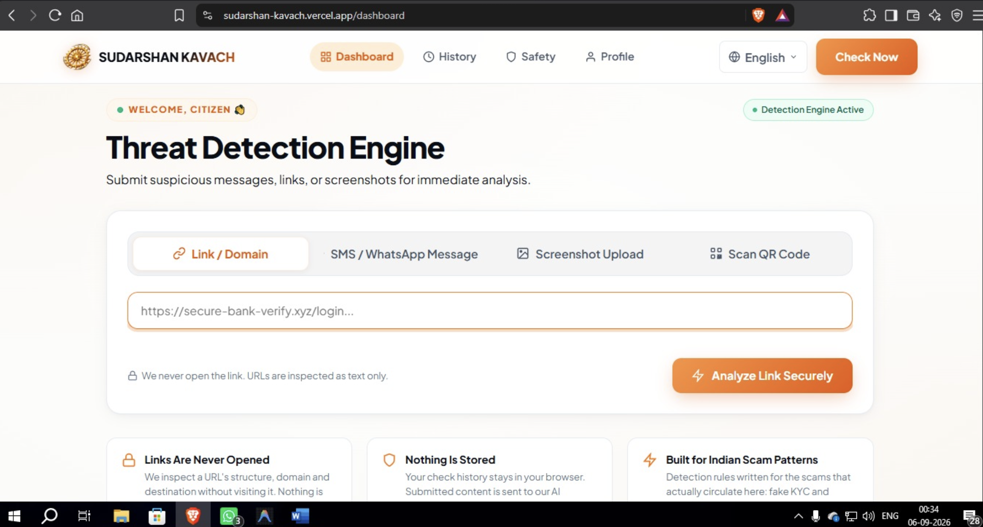
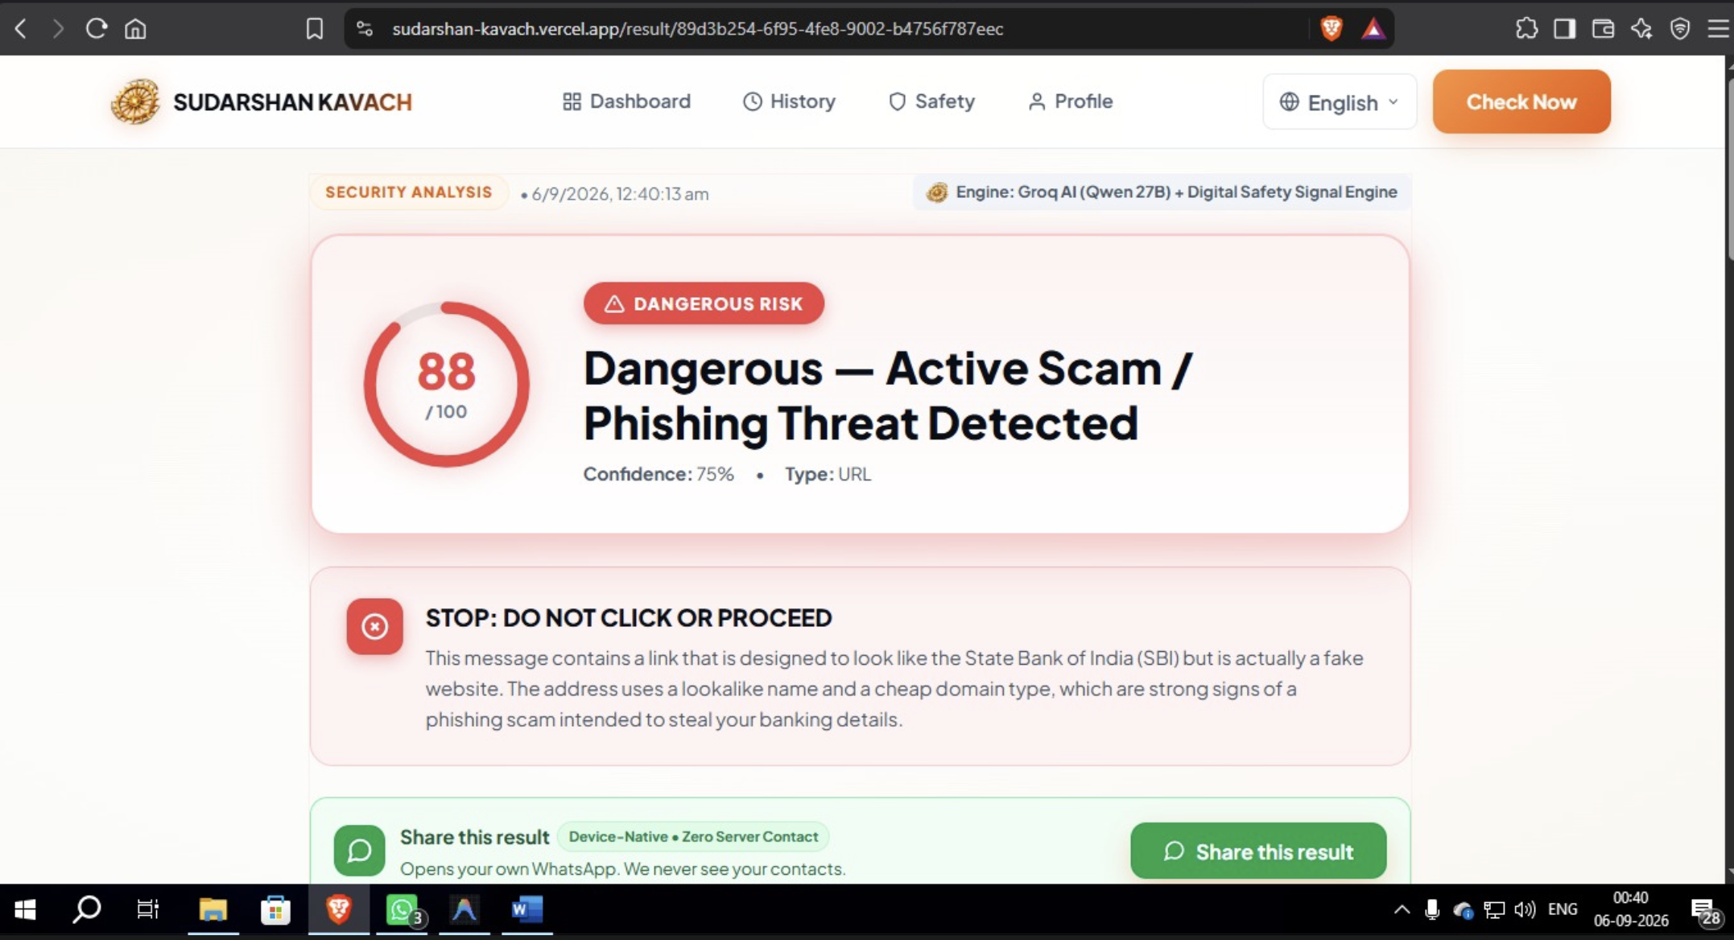
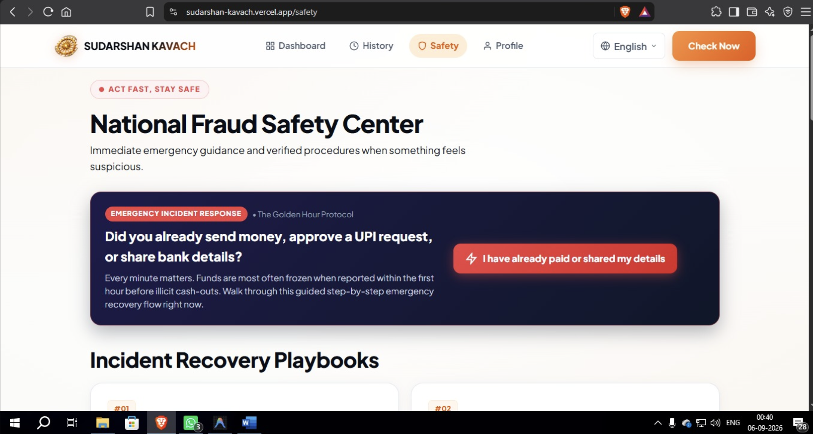
SECTION 05
Wireframes
Four key screens. Low fidelity is acceptable — show how the product works.
Screen 1
Screen 2
Screen 3
Screen 4
Entry point.
Core action.
AI or system output.
Result or dashboard.
Drop the image here.
Drop the image here.
Drop the image here.
Drop the image here.
Notes:
Four key screens. Low fidelity is fine — the flow matters more than the polish.

Slide 7
SECTION 06
AI strategy
Where AI sits in the product logic — not where it decorates the interface.
AI input
What AI does
AI output
Normalized User Content, Pre-Computed Deterministic Telemetry (Domain Intelligence, Payment Rail Metadata, Behavioral Heuristics), User Context
→
→
.
The reasoning, retrieval, generation or automation step.
What the user receives, and in what form.
HUMAN INVOLVEMENT
Where a person reviews, corrects or approves — and what happens when the AI is wrong.
Notes:
Input, what AI does, output, and where the human stays in the loop.

Slide 8
SECTION 07
Technology
Your stack. Name real tools — write “undecided” if it is still open.
FRONTEND
BACKEND
AI / MODELS
Next.JS, React, Typescript, Pure Vanilla CSS JS QR
FAST API, UV Corn, Programming Language : Python 3.14 Teseract OCR
GROQ API (Qwen 2.5 27 B)
Framework and UI library.
Language, runtime, hosting.
Which models, and how you call them.
DATABASE
APIS / INTEGRATIONS
DEPLOYMENT
N/A
Deterministic rule engine
Frontend – Vercele
Backend - Railway
Store, and vector store if any.
Third-party services you depend on.
Where the live URL will run.
Notes:
Name real tools. If a choice is undecided, say so.

Slide 9
SECTION 08
MVP scope
What ships in the demo, and what does not.
MUST WORK
SHOULD WORK
NICE TO HAVE
NOT BUILDING
We need to have atleast one possible sample message or medium to check the system
We can check the QR Code if not possible to get the QR Codes, we can check with the link behind the QR Code
A video authorization and OTP mechanism to get into the application
We have not implemented the social media chat bot as we may have to get some personal info like phone number etc
Notes:
The last column matters most — name what you are deliberately excluding.

Slide 10
SECTION 09
Validation
Evidence that you showed the concept to someone outside the team.
WHO WE TESTED WITH
WHAT WE LEARNED
WHAT WE CHANGED
We have checked with Sailesh Kulkarni, Aravind Deshpande
They were using other third-party apps which collect their personal information and take a subscription fee as well.
They liked everything and were satisfied.
We have made sure they will be using this product as webpage
Notes:
Who you tested with, what you learned, and what actually changed.

Slide 11
SECTION 10
Differentiation
Why your approach, and not what already exists.
EXISTING SOLUTIONS
OUR APPROACH
WHY IT IS BETTER
True Caller, Message filter provided by service provider like Airtel
Everything is a paid service and ours is a free one.
Our ease of checking the possible fraud and a one solution fits all need.
Notes:
Why this solution, and not the existing ones.

Slide 12
SECTION 11
Business & impact
Who benefits, who would pay, and what this becomes.
TARGET USERS
POTENTIAL CUSTOMERS
Aged people and less tech savvy people
Retired employees, Non- Technical persons.
BUSINESS MODEL / IMPACT
LONG-TERM OPPORTUNITY
We expect to be an instant hit among housewives and nontechnical persons.
This can be converted into a mobile application and made this a real time tech like antivirus in PCs.
Notes:
Who pays or who benefits, and where this goes long term.

Slide 13
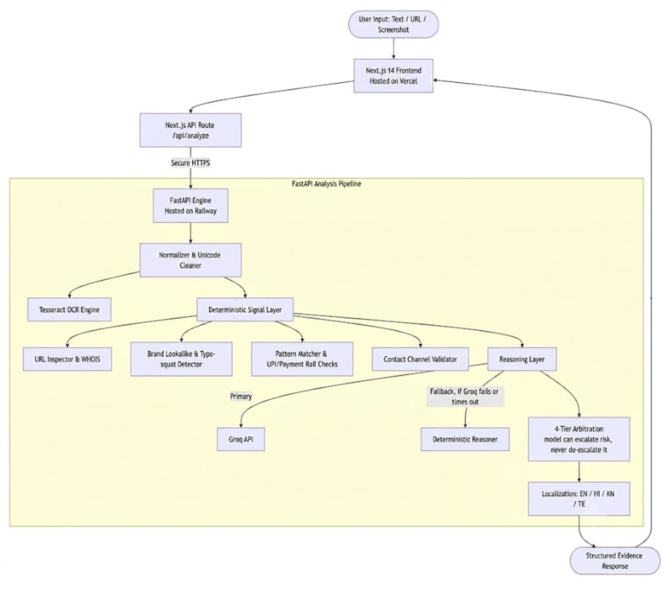
SECTION 12
Architecture
One diagram showing how the pieces connect.
ARCHITECTURE DIAGRAM
Notes:
One diagram. Show data flow, not just boxes.

